Slide 1
Get Started with the
Garnet & Gold Scholar Society

Slide 2
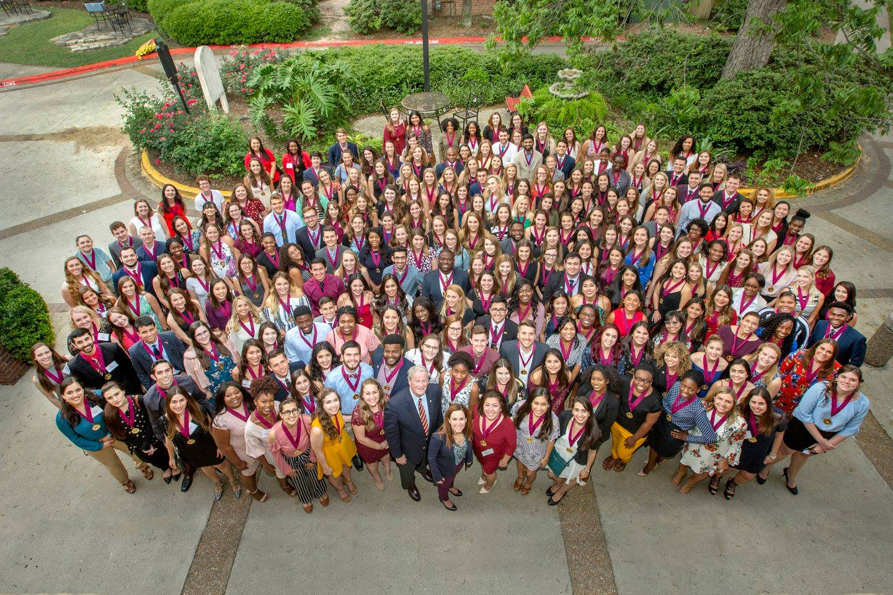
Agenda:
Program Overview
Reflection and Activity Deadlines
Writing Effective Reflections
The Formal Appeal Process
Responsibilities and Requirements
FAQs

Slide 3
GGSS Vocabulary:
Student Portal - This is where you complete everything for GGSS.
Program Administrators - GGSS is a two person staff. The program is run by a Career Center Assistant Director and one Graduate Assistant.
Overall Program Advisors (OPA) – You can be matched with an OPA to assist you through your Garnet & Gold Scholar Society journey. Your advisor evaluates your Synthesis Reflection.
Engagement Areas - These are the three activities, out of five, that you have chosen to participate in.
Engagement Area Reflections - These are the reflections you write for each of your three Engagement Area experiences.
Engagement Area Approvers - These are what we call the experts in each of the five Engagement Area fields who evaluate your reflections based off the provided rubric.
Synthesis Reflection - This is the final, culminating, reflection on your entire Garnet & Gold Scholar Society experience. This reflection is evaluated by your Overall Program Advisor if you chose to participate in GGSS with an OPA.

Slide 4
Program Overview:
Submit an application
Participate in activities for 3 of the 5 Engagement Areas:
International
Internship
Leadership
Research
Service
Complete and submit 3 Engagement Area Reflections
Complete and submit Synthesis Reflection

Slide 5
Overall Program Advisors (OPA):
Students can choose to participate in GGSS with or without an Overall Program Advisor (OPA)
OPAs are faculty and staff members across campus who are here to serve as an advisor/mentor to you through your GGSS and FSU journey.
You can choose to switch your OPA throughout your time in GGSS, or switch to participating without an OPA by emailing garnetandgoldscholar@fsu.edu
https://garnetandgoldscholar.fsu.edu/campus-partners/overall-program-advisors

Slide 6
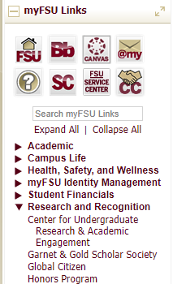
GGSS Student Portal:
You can access in one of two ways:
myFSU Portal: http://my.fsu.edu
Research and Recognition
Garnet and Gold Scholar Society
GGSS Website: https://garnetandgoldscholar.fsu.edu
Scholars
Portal Login

Slide 7
Benefits:
Learn more ways to be involved on campus
Receive unique medal at induction ceremony
Achieve special recognition at graduation
Receive special designation on official university transcript
Set yourself apart from your peers by making yourself more marketable to potential employers or graduate programs after graduation
Learn to articulate how your involvement on campus has prepared you for post-collegiate plans

Slide 8
Recognition Process:
Initial recognition includes:
Attending the GGSS induction ceremony
Receiving your GGSS medal
Recognition in the commencement program
Final recognition includes:
Recognition on your academic transcript

Slide 9
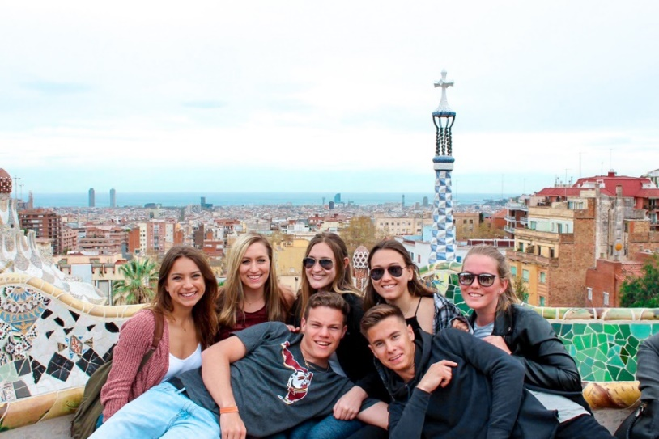
Engagement Areas:
INTERNATIONAL
Choose one:
Global Citizenship Certificate (GCC)
Global Scholars Program
An FSU approved abroad experience AND an approved intercultural communication course
*More information on the International Engagement Area can be found here: https://garnetandgoldscholar.fsu.edu/engagement-areas/international-engagement

Slide 10
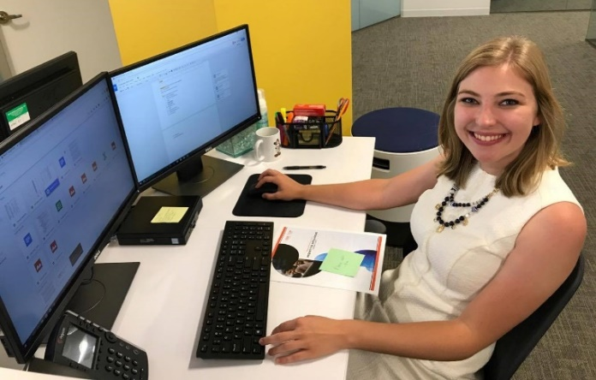
Engagement Areas:
INTERNSHIP
Choose one:
FSU Internship course on your official academic transcript
The Career Center’s Experience Recognition Program (ERP)
Option 1: Certificate
Option 2: Transcript Notation
*More information on the Internship Engagement Area can be found here: https://garnetandgoldscholar.fsu.edu/engagement-areas/internship-engagement

Slide 11
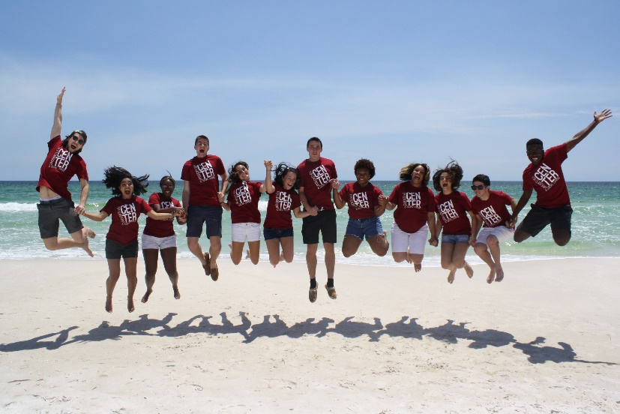
Engagement Areas:
LEADERSHIP
Choose two:
Leadership Education (from an approved list)
Successfully complete an approved 3-credit hour leadership course.
Leadership Development (from an approved list)
Participate in an approved activity/program run by an FSU College or Department and facilitated by an FSU faculty/staff mentor who is invested in the student throughout the experience for a minimum of 50 hours of participation over at least one semester.
Leadership Engagement
Engage in a leadership experience where you make positive change within your campus, local, or global community for a duration of at least two consecutive semesters and a minimum of 50 hours of participation over the two semesters.
*More information on the Leadership Engagement Area and approved courses, roles, and directions to submit a course/role for approval can be found here: https://garnetandgoldscholar.fsu.edu/engagement-areas/leadership-engagement

Slide 12
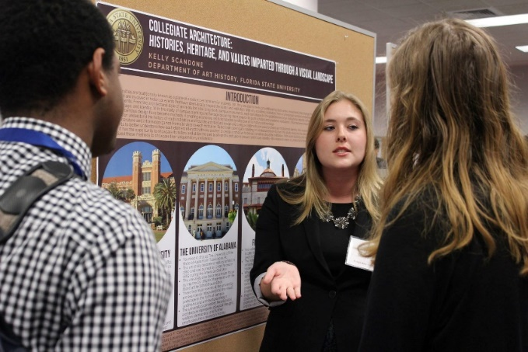
Engagement Areas:
RESEARCH
Conduct research with (choose one):
Undergraduate Research Opportunity Program (UROP)
Honors in the Major (HITM)
Global Citizenship Certificate (GCC)
An FSU faculty member for at least one semester AND complete the required public dissemination of your research
Class-based projects, e.g. Research Methods projects, are not eligible
*More information on the Research Engagement Area and directions for how to submit a non-FSU research experience for approval can be found here: https://garnetandgoldscholar.fsu.edu/engagement-areas/research-engagement

Slide 13
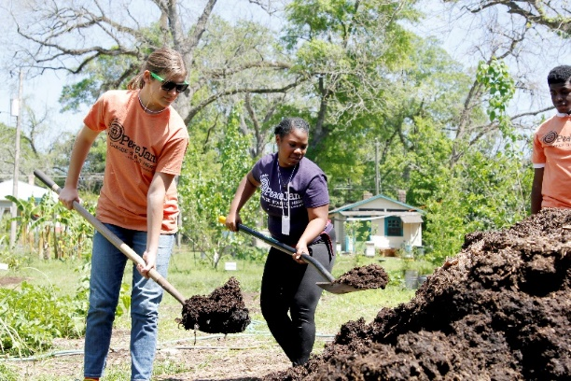
Engagement Areas:
SERVICE
Complete and document 200 hours of community service through the ServScript Program
Hours must meet ServScript criteria and be logged during the semester they are completed. Hours cannot be retroactively logged.
The last day to log hours on ServScript is the last day of the semester (last day of finals).
*More information on the Service Engagement Area and ServScript can be found here: https://garnetandgoldscholar.fsu.edu/engagement-areas/service-engagement

Slide 14
Engagement Area Deadlines:
You MUST submit an application [at least] ONE semester prior to graduation.
You MUST complete [at least] 2 of 3 Engagement Areas and their Reflections ONE semester prior to graduation.
You MUST complete the third Engagement Area Reflection and Synthesis Reflection the semester of graduation, if not before.
Students will NOT be allowed to be inducted until the semester they graduate.

Slide 15
Engagement Area Deadlines:
Activities:
Must have begun prior to Engagement Area Reflection’s deadline.
Reflections:
Must be submitted by the deadline but you may have until the final day of the semester to finish your activity.
EXCEPTION: SERVICE, GLOBAL CITIZENSHIP CERTIFICATE, & RESEARCH

Slide 16
Summer 2019 Graduating Deadlines:
Semester Graduating | Application | Engagement Area Reflections | Synthesis Reflection
Summer 2019 | February 6, 2019 | First two areas: March 6, 2019 Third Reflection: May 29, 2019 | June 26, 2019
*All deadlines are at 11:59PM on the dates listed above
*Deadlines are necessary and strictly enforced.
*If you miss a deadline, you may submit a formal appeal.

Slide 17
Fall 2019 Graduating Deadlines:
Semester Graduating | Application | Engagement Area Reflections | Synthesis Reflection
Fall 2019 | May 29, 2019 | First two areas: June 26, 2019 Third Reflection: September 18, 2019 | October 23, 2019
*All deadlines are at 11:59PM on the dates listed above
*Deadlines are necessary and strictly enforced.
*If you miss a deadline, you may submit a formal appeal.

Slide 18
Spring 2020 Graduating Deadlines:
Semester Graduating | Application | Engagement Area Reflections | Synthesis Reflection
Spring 2020 | September 25, 2019 | First two areas: October 23, 2019 Third Reflection: January 29, 2020 | March 4, 2020
*All deadlines are at 11:59PM on the dates listed above
*Deadlines are necessary and strictly enforced.
*If you miss a deadline, you may submit a formal appeal.

Slide 19
Summer 2020 Graduating Deadlines:
Semester Graduating | Application | Engagement Area Reflections | Synthesis Reflection
Summer 2020 | February 5, 2020 | First two areas: March 4, 2020 Third Reflection: March 27, 2020 | June 24, 2020
*All deadlines are at 11:59PM on the dates listed above
*Deadlines are necessary and strictly enforced.
*If you miss a deadline, you may submit a formal appeal.

Slide 20
Deadline Exceptions:
SERVICE
By the time you submit your Service Engagement Area Reflection, you will need ALL 200 hours logged on the ServScript Program.
The 200 hours include all previously submitted and approved hours on ServScript + all hours pending approval logged this semester.

Slide 21
Deadline Exceptions:
INTERNATIONAL – GCC
If completing the Global Citizenship Certificate (GCC) you can submit your International Engagement Area Reflection once you have begun making progress towards completing the certificate.
If GCC administrators see that you are making progress towards completing the certificate you will be marked as “Approved Pending Completion” until you complete the Global Citizenship Certificate.
If you chose this option, you MUST receive the certificate to complete the International Engagement Area.

Slide 22
Deadline Exceptions:
RESEARCH
You have until the semester following the completion of your Research Engagement Area Reflection to complete the required formal culmination of your research.
If you are submitting the Research Engagement Area Reflection in your final undergraduate semester at FSU you must complete the required formal culmination either prior to submitting the reflection or by the last day of the semester.
Example: Spring 2021 graduates submitting the Research Engagement Area as one of the first two reflections have until the end of the Spring 2021 semester to culminate their research.
Example: Fall 2020 graduates submitting the Research Engagement Area as their third reflection must culminate their research in Fall 2020 if not before.

Slide 23
Submitting Reflections:
Once you submit your reflection allow at least two weeks for it to be evaluated.
You will receive the below email stating the status of your reflection.
Email with status of Needs Revision
Email with status of Approved

Slide 24
Reflection Statuses:
In Progress - You have not submitted the reflection for your engagement activity.
Submitted - Your reflection is awaiting evaluation and feedback.
Needs Revision - If you receive this status the Area Approver will have given you feedback on what you need to improve. You have one week from date of evaluation (including holidays and weekends) to revise and resubmit your final reflection attempt.
Awaiting Final Approval - Your final attempt for the reflection is awaiting evaluation and feedback from the Area Approver.
Rejected - You received an unsatisfactory score on one or more rubric elements for the area on your final reflection attempt.
Approved Pending Completion - Your reflection was approved but the actual activity has not yet completed because you are participating in it during the current semester.
Approved - Your reflection and Engagement Area activities are completed.

Slide 25
Reflection Revisions:
If either an Engagement Area Reflection or your Synthesis Reflection are marked as “Needs Revision” you have:
one chance for revision
one week (7 days) to make revisions and re-submit
The opportunity to follow up with the evaluator if you have any questions.
This applies regardless of when you submit your reflections.

Slide 26
Reflection Writing Tips:
INTERNATIONAL
If completing the Global Citizenship Certificate, do know that when you choose this option in the GGSS Portal the reflection questions will disappear. This is supposed to happen. You only need to click submit as they incorporated our reflection questions into your assignments.
INTERNSHIP
If completing the Career Center’s Experience Recognition Program (ERP), do know that when you choose this option in the GGSS Portal the reflection questions will disappear. This is supposed to happen. You only need to click submit as they incorporated our reflection questions into your assignments.

Slide 27
Reflection Writing Tips:
LEADERSHIP
Ensure that you reflect on both components of the Leadership Engagement Area that you completed in all reflection questions.
3 components: Leadership Education, Leadership Development, Leadership Engagement
RESEARCH
When asked to list the key steps of your research experience you should list your day-to-day responsibilities/tasks
SERVICE
Choose one impactful service experience to reflect on throughout your Service Engagement Area Reflection

Slide 28
Synthesis Reflection:
The Synthesis Reflection gives you the opportunity to reflect on your three experiences and explain in your own words how the three experiences are related and how you have developed throughout your time in GGSS and at FSU.
The Synthesis Reflection must be submitted online by the posted deadlines and must be 1,200 words or less.
Overall Program Advisors OR Synthesis Reviewers will complete the Synthesis Reflection evaluation.
You will have one opportunity for revision.

Slide 29
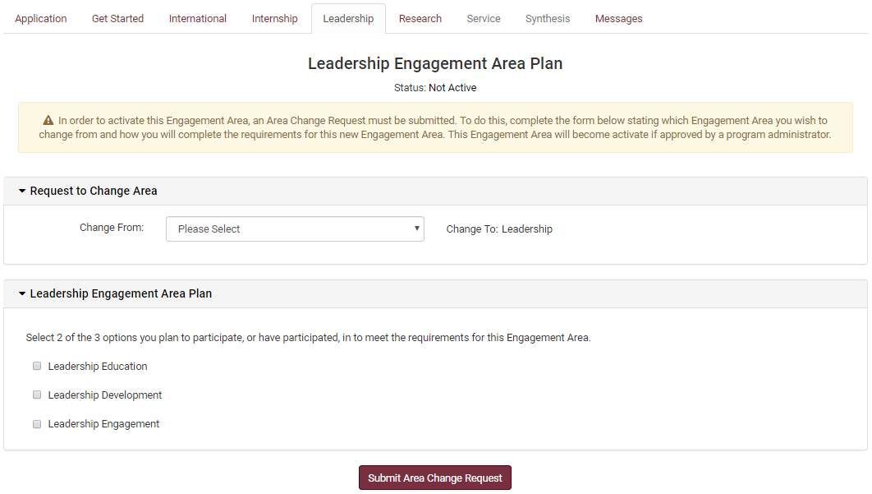
Switching Engagement Areas:
Login to your GGSS Portal
Click on the Engagement Area you want to switch to
Share which Engagement Area you want to switch from
Complete the Action Plan box indicating how you will meet the Engagement Area requirements
Submit Area Change Request

Slide 30
Appeal Process:
Appropriate for a missed deadline, rejected Engagement Area Reflection or Synthesis Reflection, or rejection of submitted activity or class.
1. Complete an appeal form (found in GGSS portal “hamburger” menu)
Submit appeal form within 2 weeks of notification of evaluation results or program removal from GGSS Administrator.
State the details and reason for reconsideration.
No further edits to reflections/synthesis will be accepted until the appeal has been reviewed.
*Only ONE appeal request may be submitted per student.

Slide 31
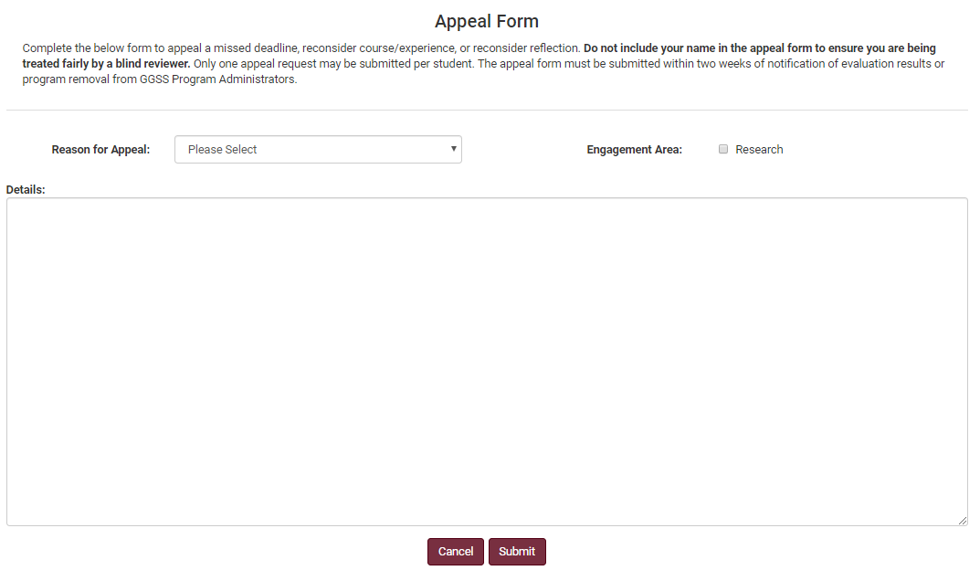
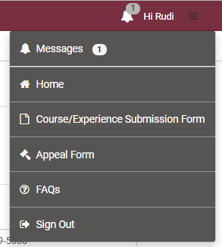
Appeal Process:
Login to your GGSS Portal
Navigate to the hamburger menu in the top right corner, and click on the Appeal Form
Choose the Reason for Appeal, the Engagement Area(s) you are appealing, and your details to be reconsidered
Click Submit and allow two weeks for the appeal request to be evaluated

Slide 32
Appeal Process:
Your appeal will be reviewed by an anonymous reviewer (Program Administrator, Area Approver, or Overall Program Advisor).
3. A Program Administrator will contact you with a decision within 2 weeks of the appeal request.

Slide 33
Graduation Checks:
Cumulative GPA of 2.75 or above at the start of your final academic semester
[ALL college coursework attempted]
Clearance from the Office of Student Rights & Responsibilities
If you have a student conduct record, you must complete all sanctions.
You must not have any record of an Academic Honor Policy Hearing.
Complete the graduation application with the University
*These checks are completed by GGSS Administrators the semester you graduate.

Slide 34
Your To Do List:
Update your expected graduation date in the GGSS portal
Submit all 3 Engagement Area Reflections and the Synthesis Reflection by your posted deadlines.
Inform GGSS Administrators of any problems or concerns as soon as possible.
Complete the GGSS Senior Survey (sent the semester you graduate).
Answer emails from GGSS in a timely fashion.

Slide 35
FAQs:
Can my experiences prior to college be used?
No, all experiences used for GGSS must occur while you are an undergraduate student.
Can I use my experiences from my time in college before I joined GGSS to meet criteria?
Yes, as long as it meets our requirements we will accept retroactive activity.
Can I use one experience for multiple Engagement Areas?
Yes, you can use one experience for up to two Engagement Areas (i.e. an internship abroad)
I am a post-baccalaureate student, can I use my experiences from my first undergraduate degree for GGSS?
Yes, if your experiences meet our requirements you can use them since you were an undergraduate student.
Other FAQs can be found here: https://garnetandgoldscholar.fsu.edu/about/faqs

Slide 36
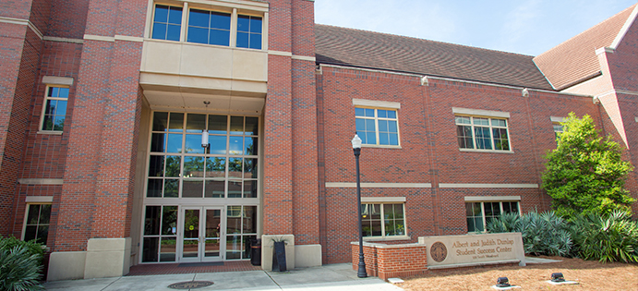
Next Steps:
Successfully pass the Get Started quiz on your GGSS portal with 100% to gain access to your Engagement Area tabs
Questions:
Come to our drop-in advising hours!
https://garnetandgoldscholar.fsu.edu/contact-us/drop-advising-hours
Location: Career Center, Dunlap Success Center
Phone: 850-644-8625
Email: garnetandgoldscholar@fsu.edu
Website: http://garnetandgoldscholar.fsu.edu

